Slide 1
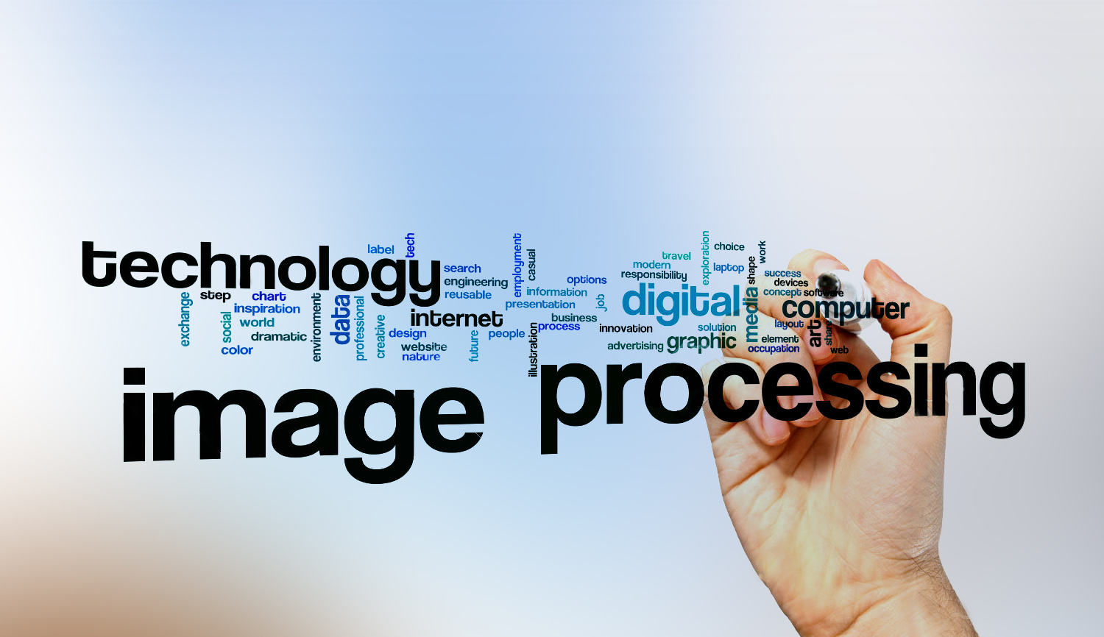
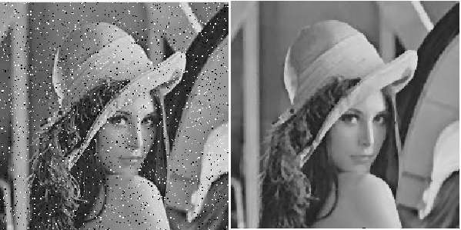
Digital Image Processing
11-give an example of image addition.
Adding noise to the original image

